Slide 1




Database Continuous Delivery & Your Salvation!
John Morehouse
Consultant
Denny Cherry & Associates Consulting
john@dcac.com
http://linkedin.com/in/sqlrus
@SqlRUs
http://www.sqlrus.com

Slide 2
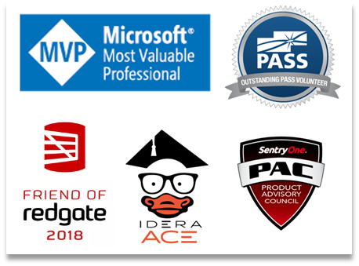
Who Am I?
Leader of the Louisville SQL Server/Power BI User Group
Organizer/Speaker of SQL Saturday’s & other conferences
Heavily involved with SQL PASS
Microsoft Data Platform MVP
Friend of Redgate 2015 - 2018
Idera ACE 2016
SentryOne Product Advisory Council

Slide 3
Where Am I?
The vetted and certified experts at Denny Cherry and Associates Consulting assist companies with attaining IT goals such as HA, scalability, SQL Server virtualization, migration, and acceleration reliably while finding ways to save on costs. With clients ranging from Fortune 50 corporations to small businesses, their commitment to each is the same: to provide a deft, high-speed IT environment that leverages every aspect of their platform: from architecture, infrastructure, to network.
Visit DCAC at http://www.dcac.co

Slide 4


Agenda
What Is It?
Adoption Rate
How Does It Work?
Why Do I Care?
Security
Collaboration
Deployments
Demo
Salvation
How to Sell It

Slide 5

The Elephant…
This Photo by Unknown Author is licensed under CC BY-SA
Notes:
I’m probably the elephant in the room……I am a die-hard database administrator and I can probably barely spit out a “Hello World!” in c#.
But I love continuous delivery for databases.

Slide 6
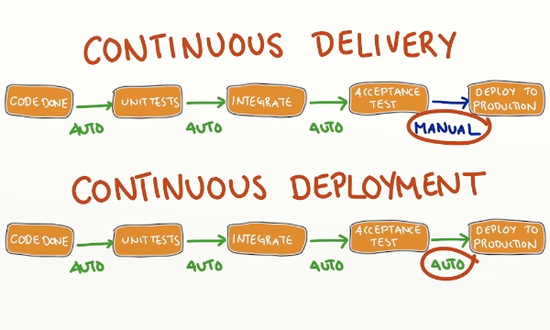
What Is It?
Continuous Delivery
Continuous Deployment
Bad Things
Source: http://blog.crisp.se/2013/02/05/yassalsundman/continuous-delivery-vs-continuous-deployment
Notes:
Continuous Delivery is usually delivery of application/database changes automatically up to the environment just before production. We can go to Production if it was decided, but human intervention is still required. Database continuous delivery is always complicated by the data. We use tools to generate automatic deployment elements (artifacts) to be deployed to various environments.
Continuous deployment is all the way into production once the change is checked into source control and all testing is passed. This requires rock solid testing methodologies on all fronts. Very difficult to accomplish.
Shared development model means that every developer will develop on the same database instance and/or database.

Slide 7
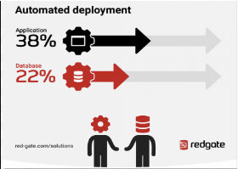
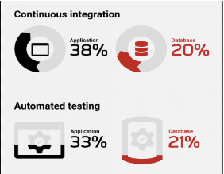
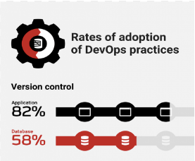
Adoption Rate
1000 SQL Server database professionals
Range of industries and company sizes
Had or planning to adopt DevOps practices in their organization

Slide 8
Database Continuous Delivery
Development Model
Dedicated
Shared
Source Control Tools
Redgate Source Control
Visual Studio
SSDT
Continuous Integration (CI)
Team City
Jenkins
Release Manager
Octopus Deploy
MS Release Manager
Azure
ReadyRoll
State
Migration
Bamboo
Notes:
MAKE SURE TO TALK ABOUT THE DEDICATED VS SHARED
MAKE SURE TO TALK ABOUT THE STATE VS MIGRATION

Slide 9


How It Works….
Source Control System
CI/Build Server
Failed
Testing
Passed Tests?
Build & Test
Release Manager
Staging
Production
Notes:
The release manager then determine which environment it needs to be deployed to. This can be manual or configured for an automatic deployment. This can also be configured to allow for a “review” process to ensure the changes are valid and consistent. Think of this as a final gatekeeper.

Slide 10

Why Do I Care?
Security
Consistency
Collaboration
Ease of Deployments
Continuous Delivery allows me to:
Work Smarter, Not Harder
Quit Being the Bottleneck
Provide Feedback Faster
Deploy Changes Faster
This Photo by Unknown Author is licensed under CC BY-NC
Notes:
Security is and should be forefront in everybody’s mind. Continuous delivery allows us to lock down all environments except for development
Process consistency ensures that things are deployed in a consistent manner. This ties in with testing and ensuring that everything is tested in the same manner. It’s also repeatable.
Once things are tested thoroughly, a release management software such as Octopus Deploy allows us to deploy the “package” to production with a touch of a button. It can also be scheduled. No more late night deployments. This is scary.
By having consistent testing, the DBA’s are no longer the bottleneck in the deployment process. If there is a code sniffer (SQL Enlight/SQL Cop) looing for bad design/code patterns in the process, developers can get even faster feedback on required changes without a DBA being involved.
DBA’s can then focus on other things such as new design architecture or improving the environment.
If the process has testing built in, via tsqlt or other methods, then the developers of the change can get faster feedback on issues. The DBA is no longer the bottleneck.

Slide 11

Security
Lock Down Non-Prod Environments
Release Manager Will Do All of the Work
Reduced Security Foot Print
Happier DBA’s
Local SQL Server Instances
Dedicated Development Environment
Notes:
Locking down the environments from changes forces all development changes through the process. Except for production issue changes.
The release manager software will have the appropriate permissions to do the work. It won’t need SA rights but most likely DBO.
A dedicated development environment

Slide 12
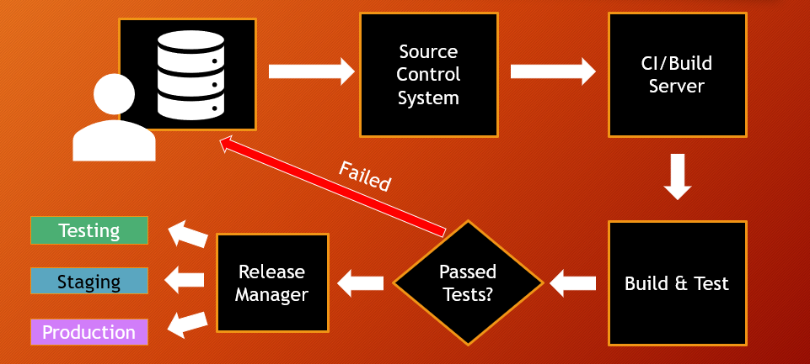
Security
Locking Down Environments Enforces Consistency
Notes:
If all permissions (except for db_datareader & maybe db_datawriter) are removed from all environments except for Development, then all changes are forced into the continuous delivery route. The only way to get a change into production is through the continuous delivery process.
If the Production DBA needs to make an emergency change, they should be diligent for getting that change back into source control or work the process.

Slide 13
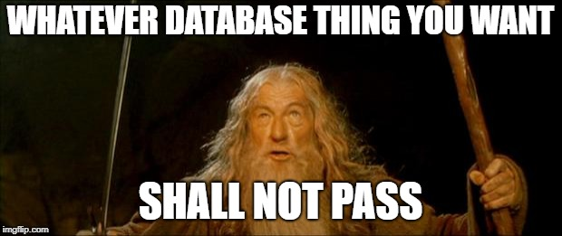
Are your DBA’s like this?
This Photo by Unknown Author is licensed under CC BY-NC

Slide 14
Collaboration
DBA’s
Quality Assurance
Developers
Forces Developers to Talk to Other Developers
Forces Developers to Talk to DBA’s
Forces DBA’s to Talk to Developers
Notes:
If the environment is in a dedicated model, meaning each developer has a copy of the database, then developers must communicate with each other to avoid conflicts when checking in.
Same is also true for the database developers and/or DBA’s.

Slide 15
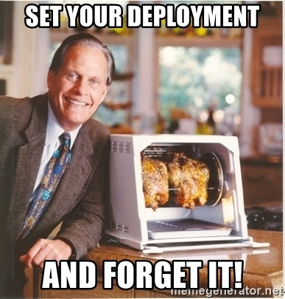
Deployments
Using a Release Manager
Probably Not The DBA’s Normal Routine
Possible One Click Deployments
Code
Database
Deploy on a Schedule
Set it & Forget it
Notes:
Trusting the tools that you have in place to handle the deployments, such as Octopus Deploy is different than hitting F5.
Deployments become easier to maintain

Slide 16


Slide 17

The Salvation..
Continuous Delivery will….
Help Reduce Security Foot Print
Enforce Consistent Methods
Enforce Consistent Testing
Speed up Delivery to All Environments
Faster Feedback to Develop Teams
Reduce the DBA Bottleneck
All of the above will…..
This Photo by Unknown Author is licensed under CC BY
SET YOU FREE!!

Slide 18

How to Sell it…
Easier Deployments
Faster Deployments
Trust the tools
Better SECURITY!
Better Code
This Photo by Unknown Author is licensed under CC BY-SA
Notes:
However, if you think you need help with it, I recommend….

Slide 19
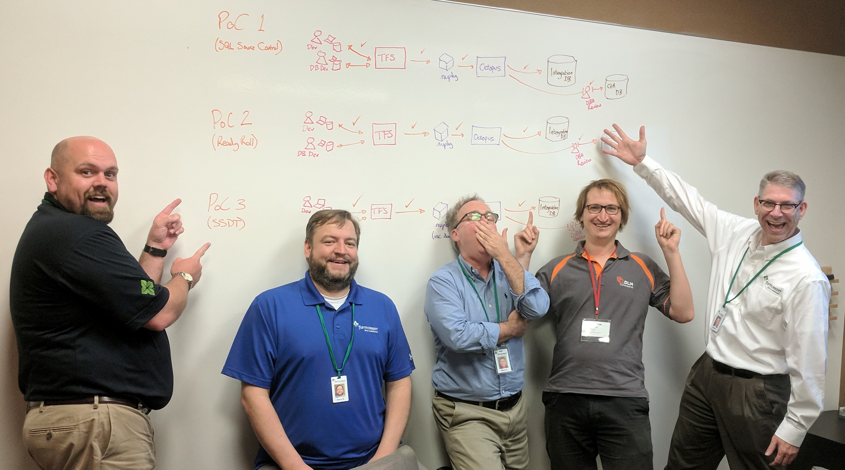

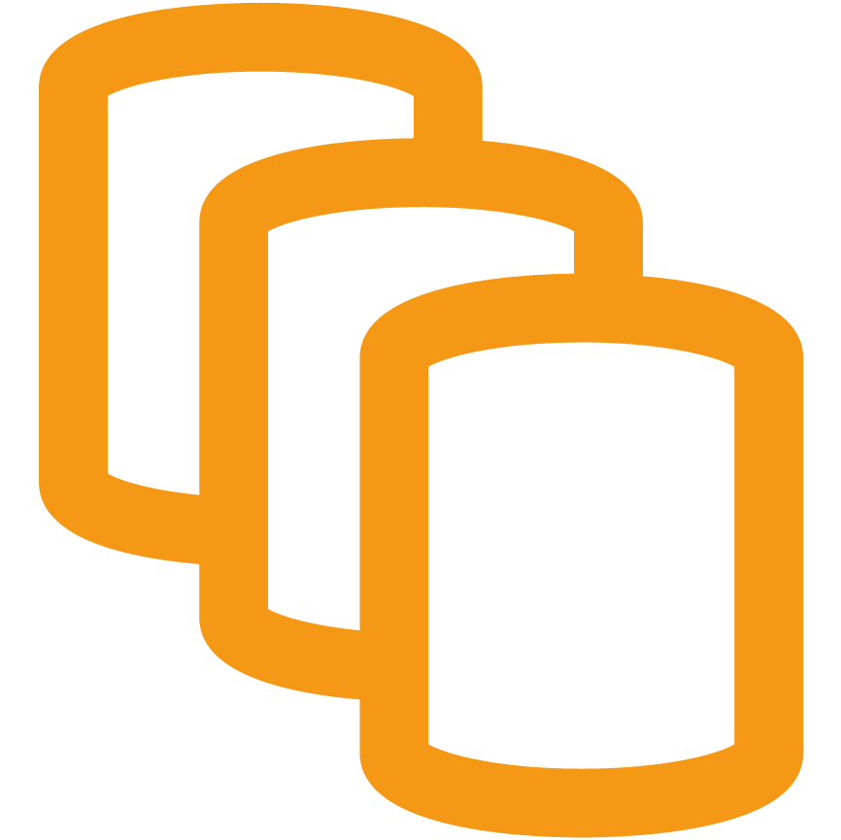
Our implementation of DLM ranks as the most beneficial infrastructure project that I’ve witnessed in my 26-year IT career. Database deployments no longer represent a bottleneck in our software delivery process. The process improvements realized by this technology touch all team members. Developers, QAs & DBAs communicate as releases move through the pipeline. DLM makes us more productive.
Steve Cornwell, Enterprise Database Developer at Farm Credit Mid-America, ex-Microsoft
enquiries@dlmconsultants.com

Slide 20
Resources
CI/Build
Team City - https://www.jetbrains.com/teamcity/
Jenkins - https://jenkins-ci.org/
Testing/QA
SQL Enlight - http://www.ubitsoft.com/products/sqlenlight/
TsqlT - http://tsqlt.org/
SQL Test - http://www.red-gate.com/products/sql-development/sql-test/
Release Manager
Octopus Deploy - https://octopusdeploy.com/
TFS - https://docs.microsoft.com/en-us/azure/devops/pipelines/overview?view=tfs-2018
DLM
Redgate DLM - http://www.red-gate.com/solutions/database-devops/
Redgate DLM Dashboard -http://www.red-gate.com/products/dlm/dlm-dashboard/
Redgate State of DevOps - https://www.red-gate.com/solutions/database-devops/report
eBook - https://leanpub.com/database-lifecycle-management/

Slide 21
THANK YOU!!!!
john@dcac.com
http://linkedin.com/in/sqlrus
@SqlRUs
http://www.sqlrus.com

